Slide 1
Financial News Headlines Analysis Project - Stock Market Fin - LAFIO

Slide 2
Fin-LAFIO Team
Domain Experts
IT Experts
Lina Shbaitah
Issa Baitouni
Omar Ja`bari
Ayman Khalaf
Firas Abu Nimreh

Slide 3
Project Goal
To create a platform to help people, who are interested in the stock market, make their investment decision based on the insights they get from our platform (Fin-LAFIO).
Fin-LAFIO will provide insights extracted from the following factors influencing the stocks prices:
News Headlines.
Major analysts`/influencers tweets, blogs, and analysis.
Gossip.

Slide 4
Problem Statement and Value Proposition
Fin- LAFIO's role is to gather all these elements in one place and make the process easier and more insightful for users.
(One-Stop-Shop)
It is overwhelming for investors to decide to buy, sell or keep a stock.
Many aspects to consider when deciding.
The stock price is determined by supply and demand,
Stock price are affected positively or negatively by many factors including; news headlines, company value/performance, key people analysis, and gossip in the market.

Slide 5
Project Persona
Business To Customer – 1st Stage
Beginner investors
Mid – experienced stock investors
Business To Customer – 2nd Stage
Experienced Stock investors
Business to Business – 2nd Stage
Businesses/traders who will make the decision on behalf of investors (Fin-LAFIO will be used to predict future prices)

Slide 6
Fin-LAFIO Model Data Inputs
Date
Time / Periods (of news/tweets)
News Headlines
Tweets
Sentiments
Prices (change in the price depending on the sentiment)
Stock (company, geographical location, industry)

Slide 7
Fin LAFIO - Model Features
Correlation between news headlines and stock prices
One-Stop-Shop
Insightsfull
Accurate The model will be used for a different financial market & different stocks
Behavior & Sentimental Analsis
Short and long-term prediction
Dashboards
User Friendly

Slide 8
Data Source & Type
Data Source:
News Headline ( CSV – Unstructred from Kaggel
Apple Stock Price ( CSV – structured from Yahoo)
Nasdaq Index ( CSV – structured from Yahoo)
Data Description
Includes news headlines and opinions from different sources for many companies. Only news and opinions related to Apples.
Stock price & traded volume
Index price & traded volume

Slide 9
Our Work Flow
As a Start – Apple stock as a case to study
News headlines for Apple company collected from Kaggle (2012-2020)
Nasdaq Index Dataset collected from Yahoo.
Data Analysis

Slide 10
Data Distribution
Open-source derived data:
Will be shared and distributed according to the best ethical practices.
Outsourced articles, blogs, sites:
Will be referenced to the owner as a part of our ethical commitments.
Any other newly generated data:
Will be shared as part of the subscription plan ( type & size ) and services.

Slide 11
Data Availability:
Limitted access for all free account.
Access to data based on several options of subscription plans & paid accounts.

Slide 12
Hypothetical Questions

Slide 13
Question we would like to Answer
What is the impact of the frequency of financial news headlines on the stock price?
What is the effect of Quarterly financial reports on stock prices?
Is there a relationship between timely news and stock prices?
Does news (other than financial) affect the stock prices?
Can stock prices be predicted in the short and long-term depending on the news headlines?
Which comes first (news, sentiment then change in the price) Or (change in the price in the major/most important stocks then news spread)?
What is the relationship between the investor type (investment strategy used) and stock prices?
What are micro and macro reasons/causes of a change in the stock prices
Do news headlines have the same effect/impact on all users in the different geographical areas? (The way users deal with the news; does it differ from one location to another?)
Are there cultural differences in dealing with the news?

Slide 14
Question we would linke to Answer
Can stock prices be predicted depending on sentiments? (Can a mathematical model be used to predict stock prices?
What are the different sources of news?
What is the impact of the source of the news on the stock prices (if it is a governmental statement, or a company and industry news, or gossip) (Effect of news types (such as noise news) on the stock price)?
Does the news have the same effect on all users/stocks? (Bad news for some, good news for others).
Which industries are more (sensitive to/stable against) news? (What is the relation between the news and stock prices in a certain industry/sector?)
Is there a relation between the way (medium) and speed of news (how the news is transmitted) (using tweets, conferences, web...etc.) and stock prices?
Do seasonal trends affect stock prices?
What is the effect of market makers (setters) on changing stock prices? (Impact of the market makers as the source of the news).

Slide 15
EDA Report

Slide 16
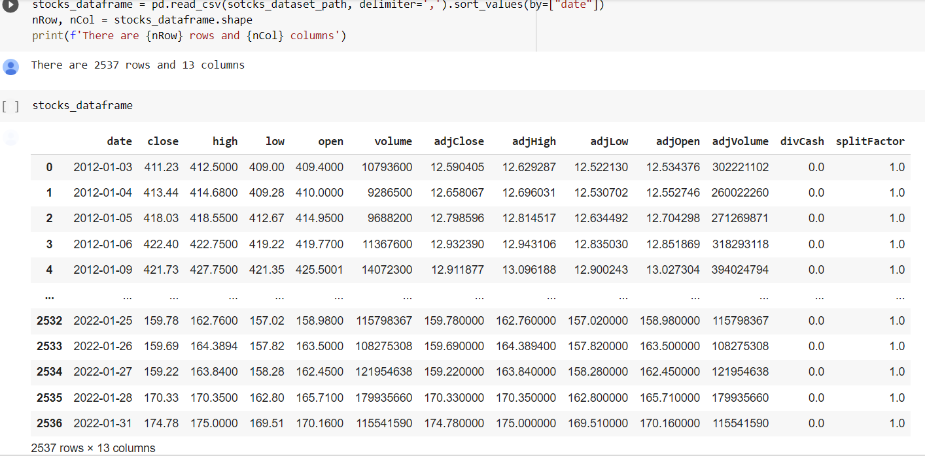
Apple Stock – stocks_dataframe 1/2012 – 1/2022

Slide 17
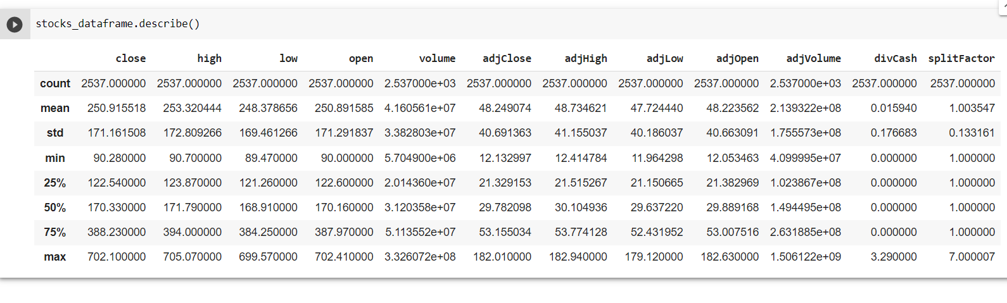
Data Frame Description

Slide 18
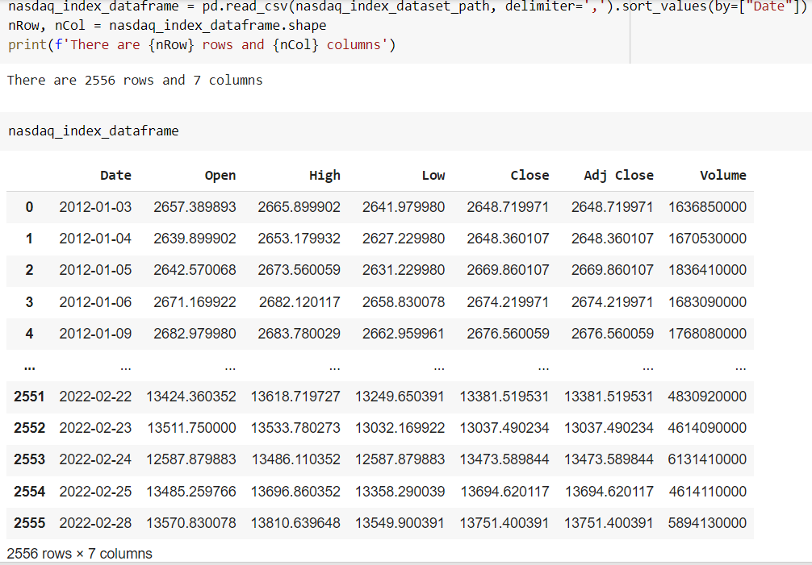
Nasdaq_index_dataframe 1/2012 – 2/2022

Slide 19
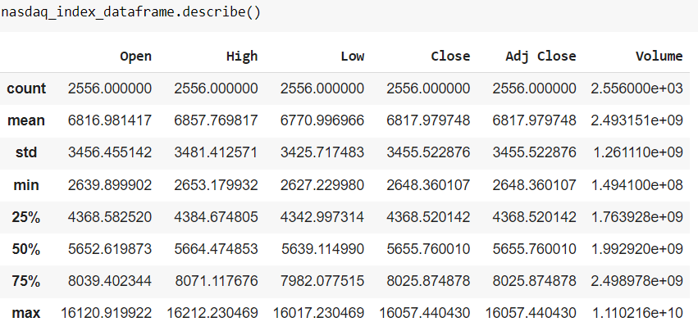
Data Frame Description

Slide 20
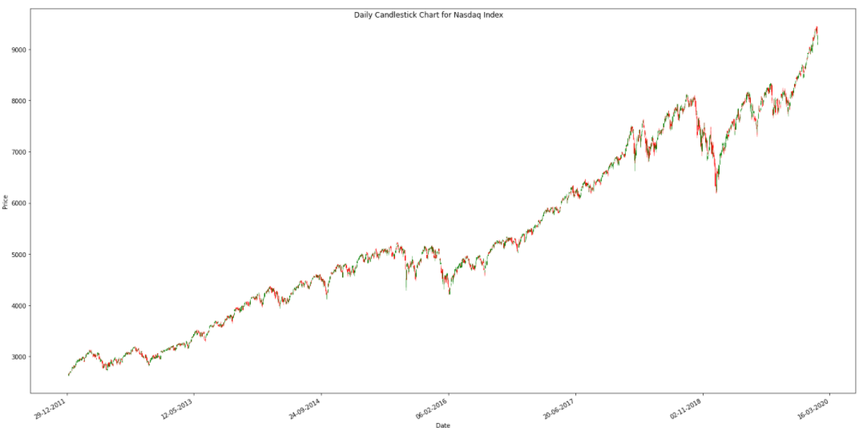
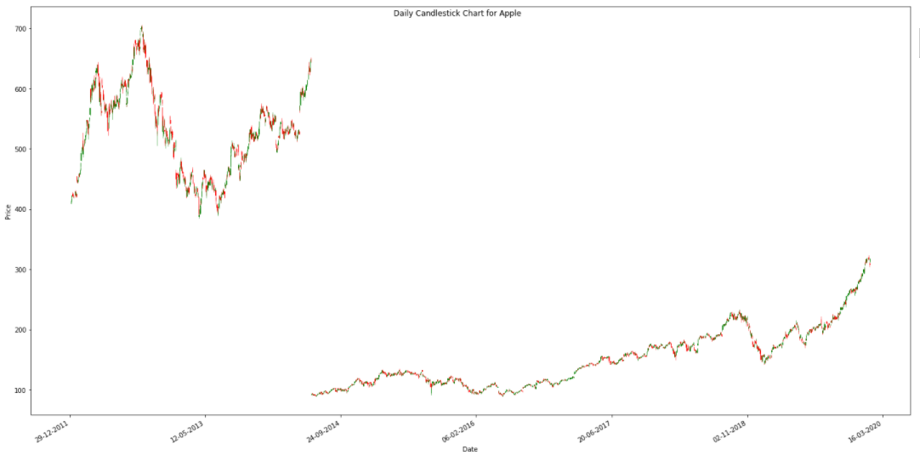
Movement of the Close Price of Apple + Nasdaq (2012 – 2020)
* shows the stock split that apple did.

Slide 21
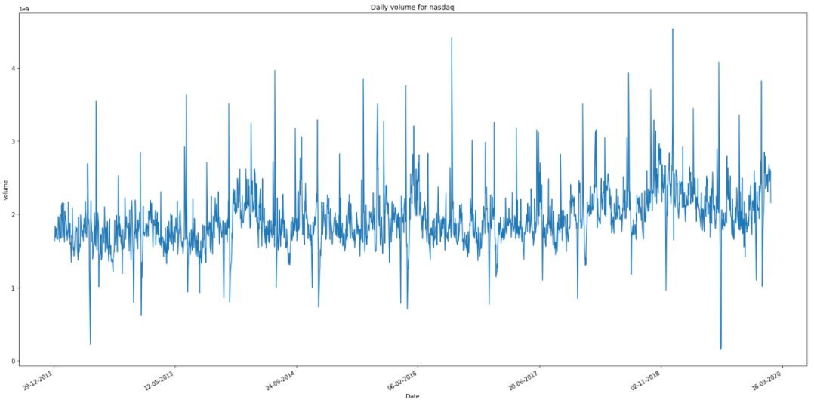
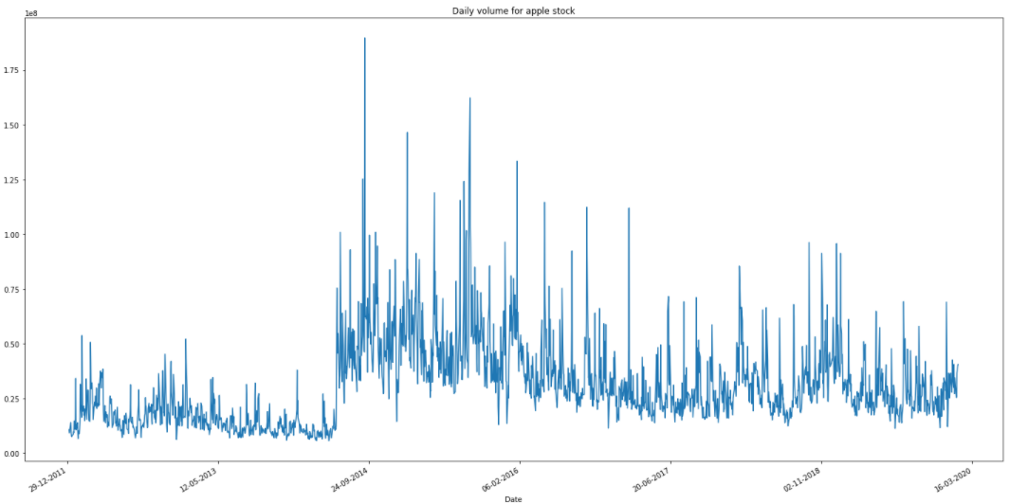
Movement of Traded Volume of Apple + Nasdaq (2012 – 2020)

Slide 22
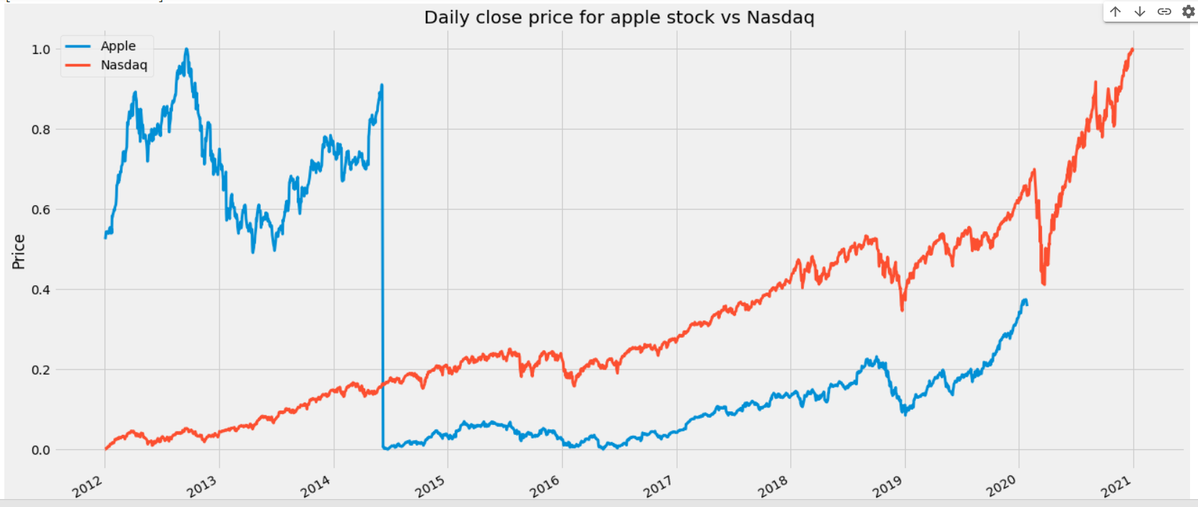
In general Apple stock is following the Nasdaq trend (when Nasdaq Index increases, Apple increases). You will notice that there is a drop in Apple price in 2014, this was due to a (7 for 1) stock split done 9/6/2014 - stock changed from $633 to $92.

Slide 23
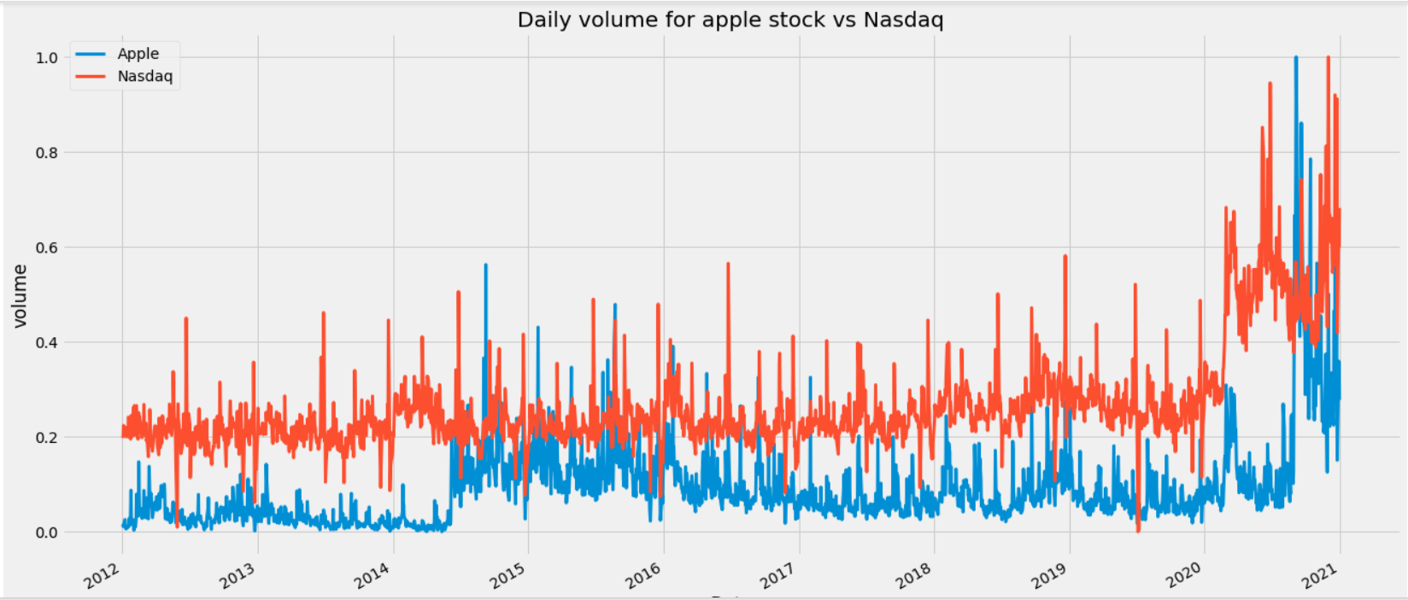

Slide 24
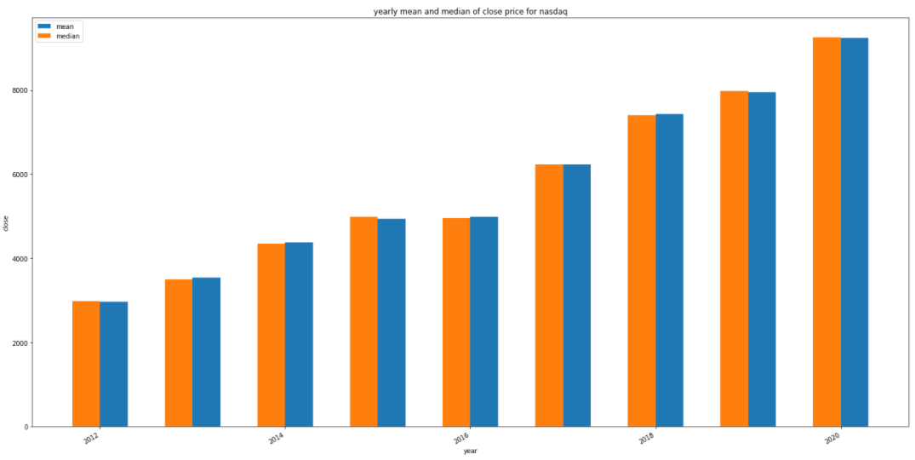
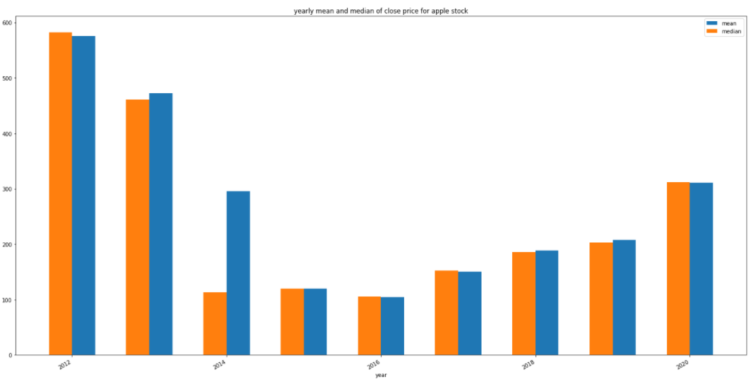
Yearly Mean and Median of Close Price

Slide 25
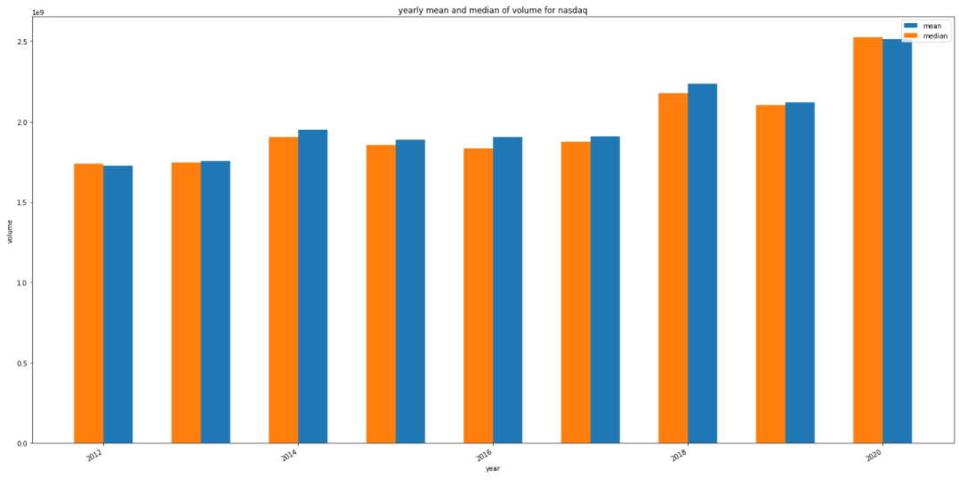
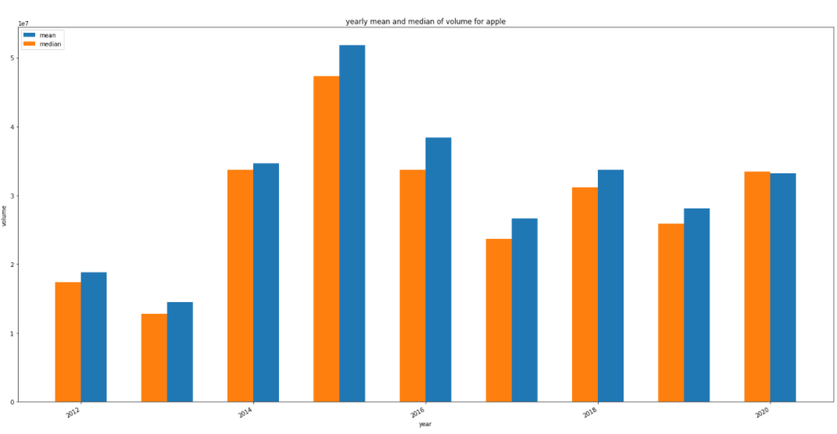
Yearly Mean and Median of Traded volume

Slide 26
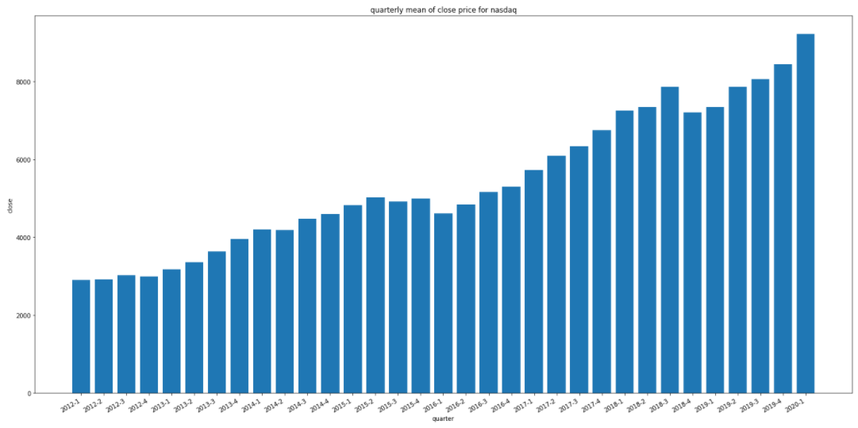
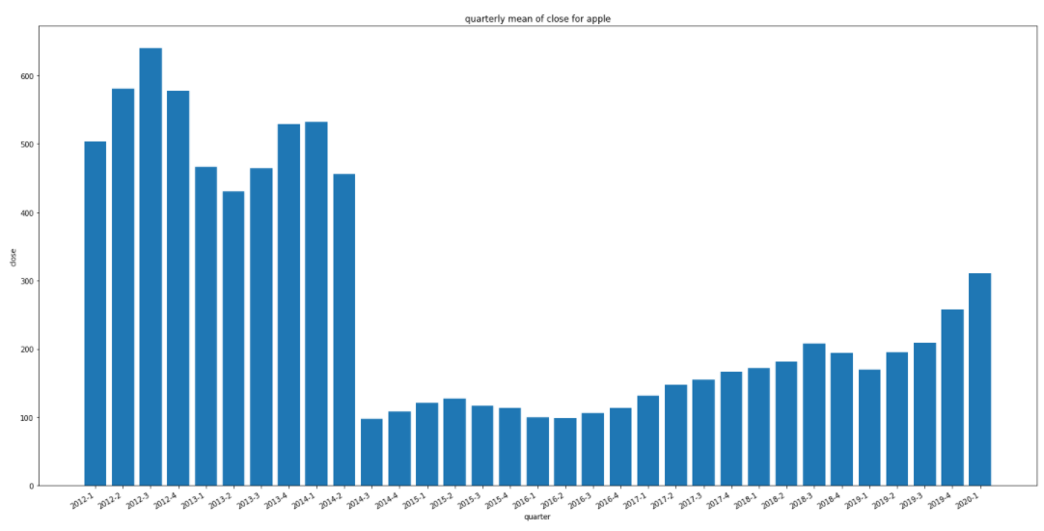
Quarterly Close Price - Mean

Slide 27
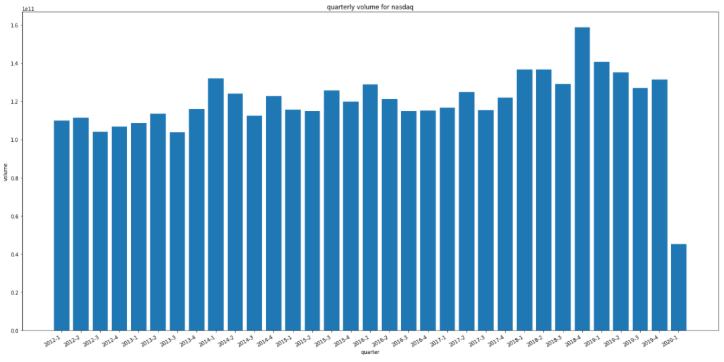
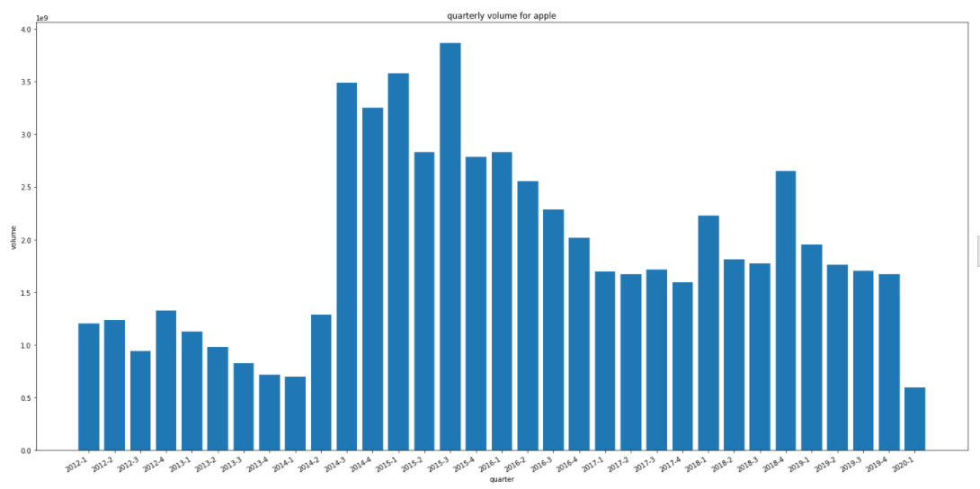
Quarterly Traded Volume - Mean

Slide 28
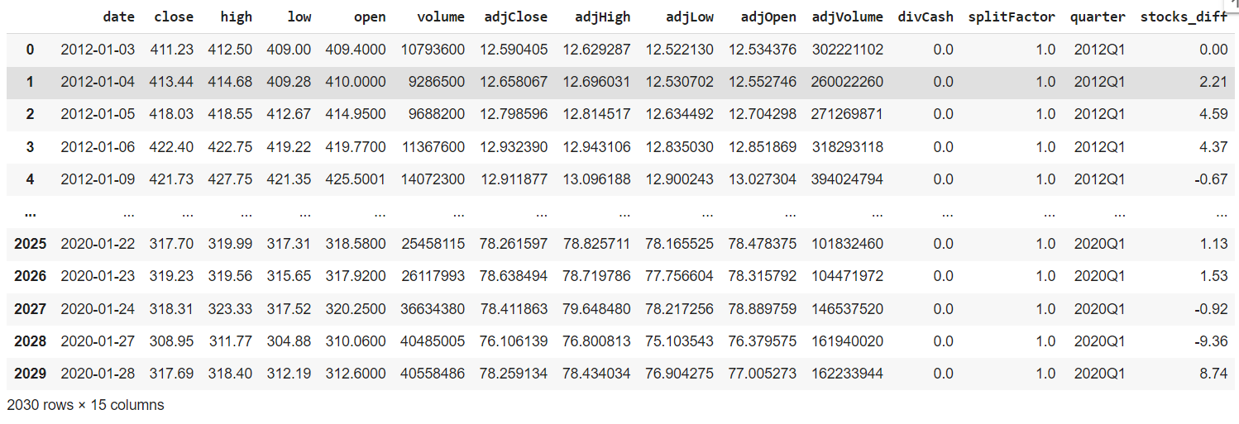
Stock Difference Column

Slide 29
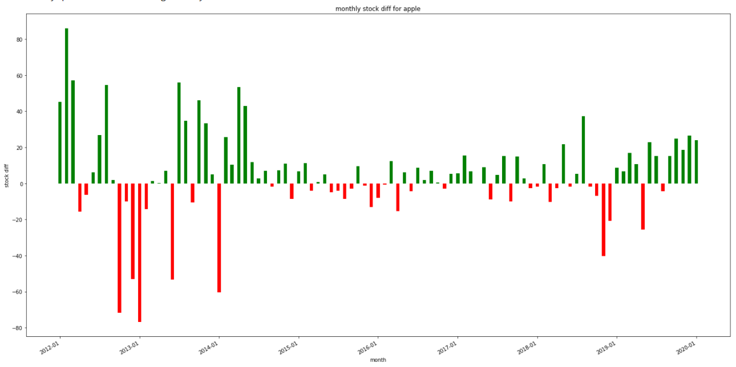
Monthly Change - Apple stock (Monthly Stock_Diff)

Slide 30
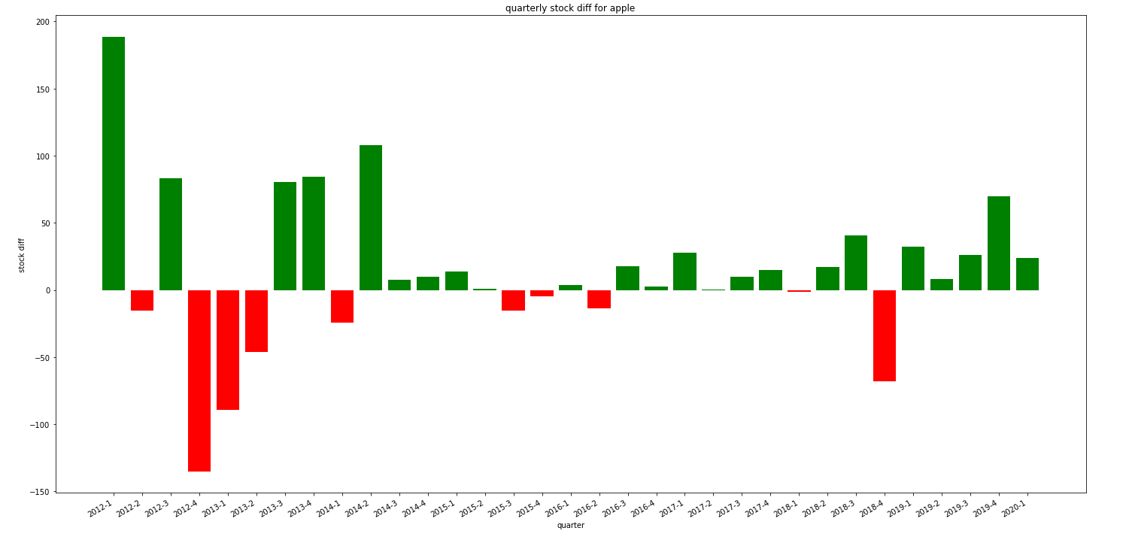
Quarter Change - Apple stock (Monthly Stock_Diff)

Slide 31
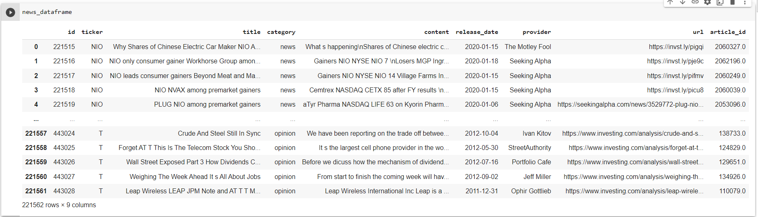
News Headlines (news_dataframe) 2012 – 1/2020

Slide 32
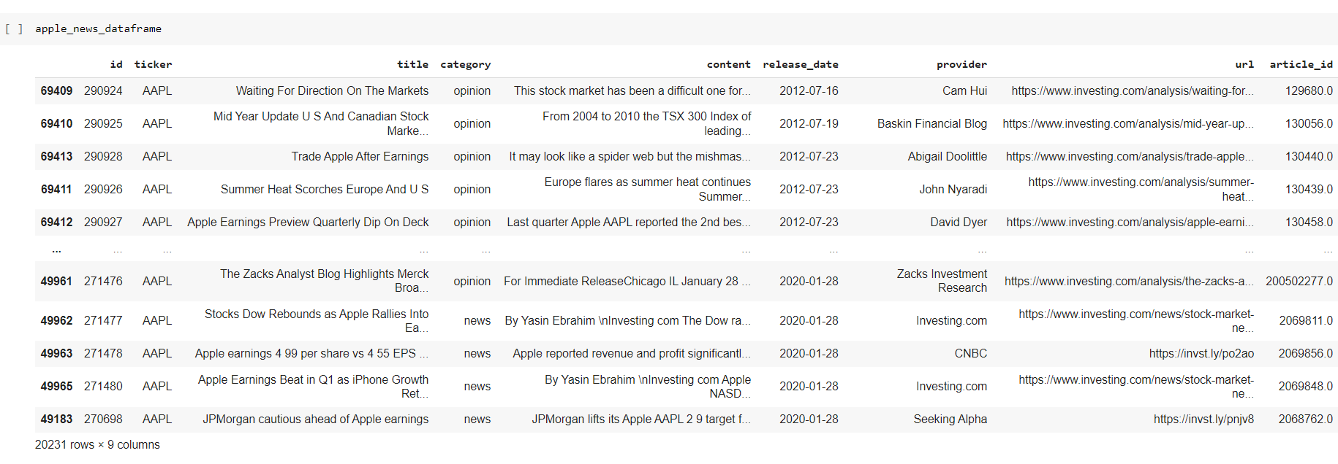
Apple_news_dataframe

Slide 33
In 2012- 2020 there were 221,562 headlines about different companies including Apple, Microsoft, and Amazon. Apple company had the largest number of headlines with 20,231 news divided into:
News (32.8%) - Main providers of news were (in order): Reuters, Investing.com, Seeking Alpha, Bloomberg, CNBC, The Motley Fool, International Business Times, and MarketWatch.
Opinions (67.2%) – Main opinion providers were: Zack Investment Research (67.5% of opinion provider) and others.

Slide 34
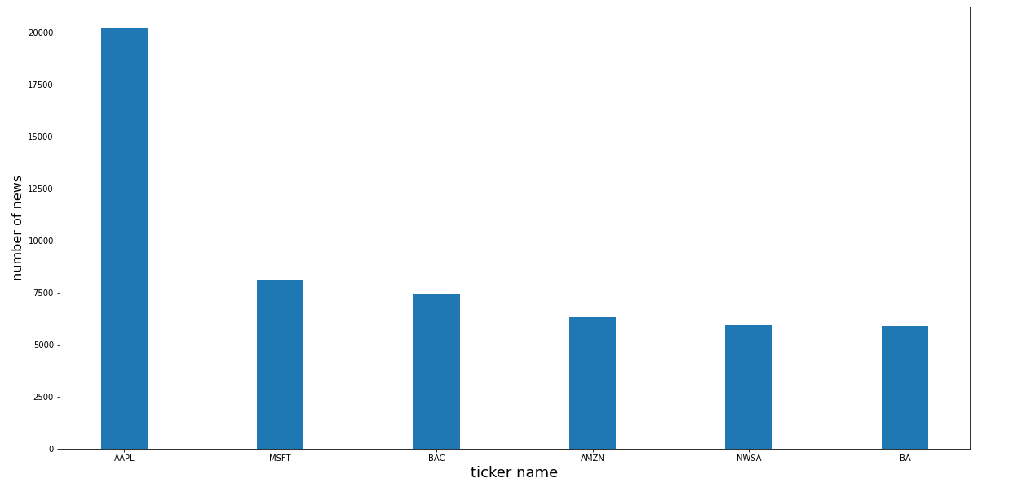

Slide 35
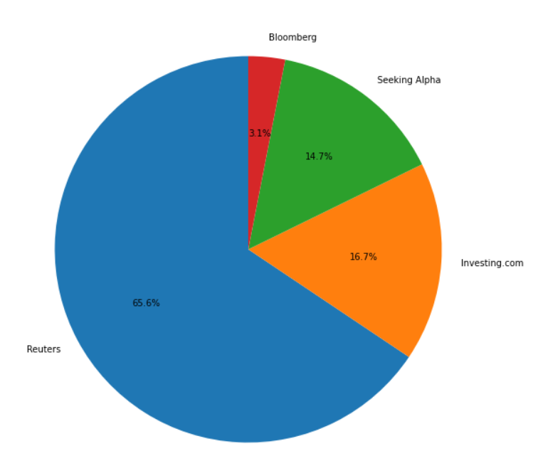
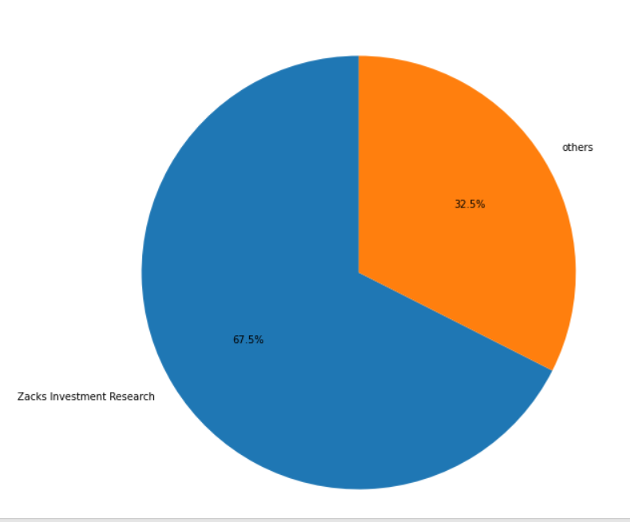
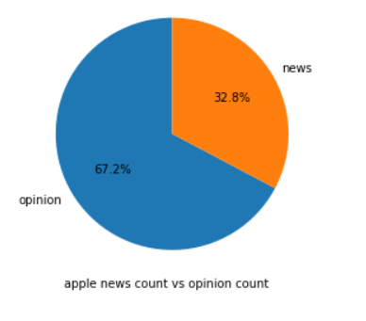

Slide 36
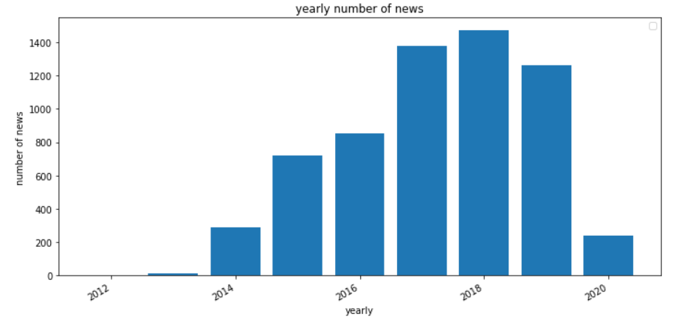
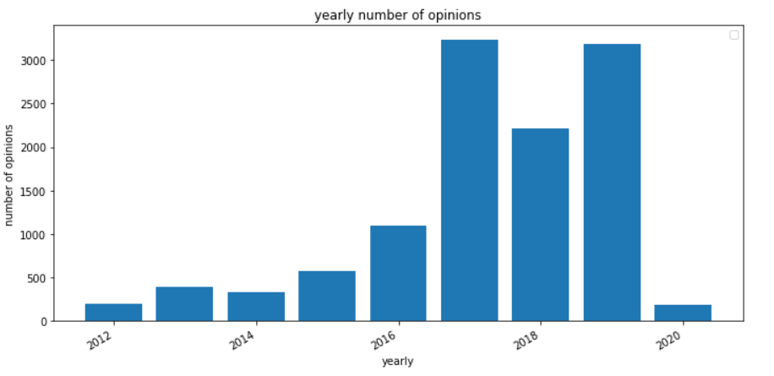
Yearly

Slide 37
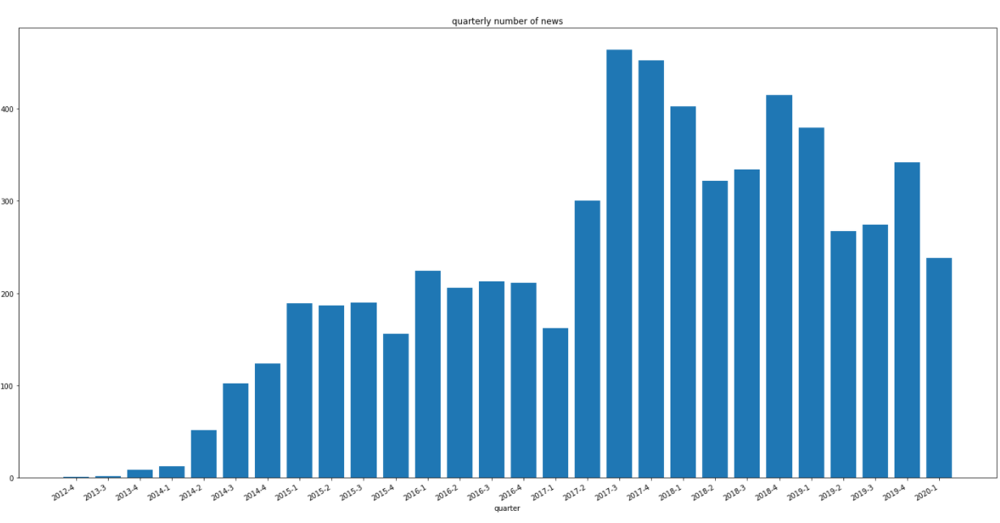
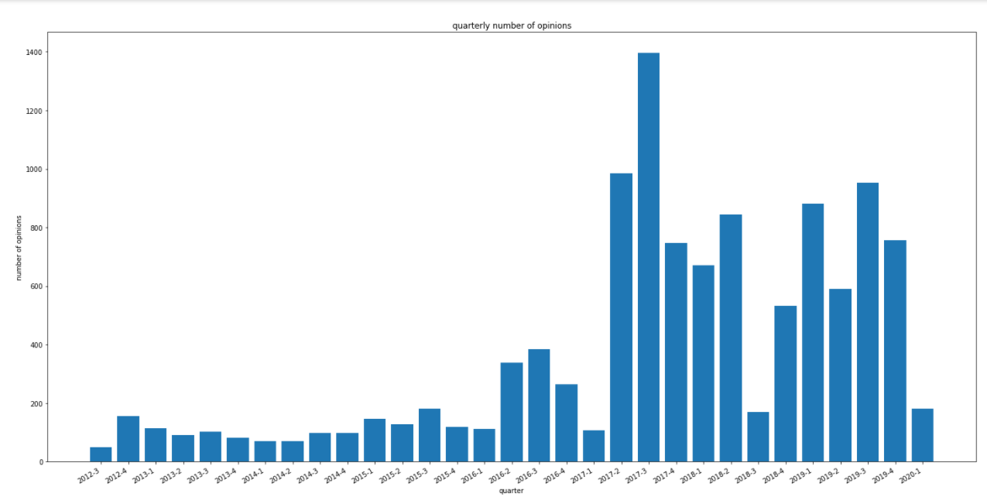
Quarterly

Slide 38
News & Opinions were described as negative or positive depending on the change in the price (stock_diff column)
If the price increases , then it is a positive news/opinion
If the price decreases , then it is a negative news/opinion.
Stocks data frame was combined with the news data frame (using the stock_diff column).

Slide 39
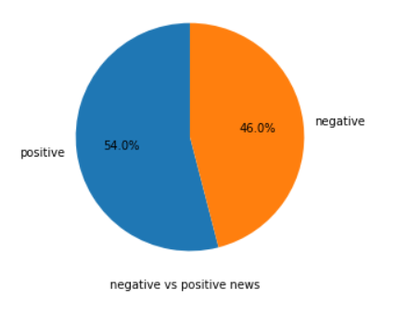
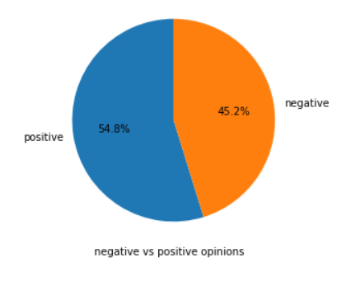
Positive VS. Negative

Slide 40
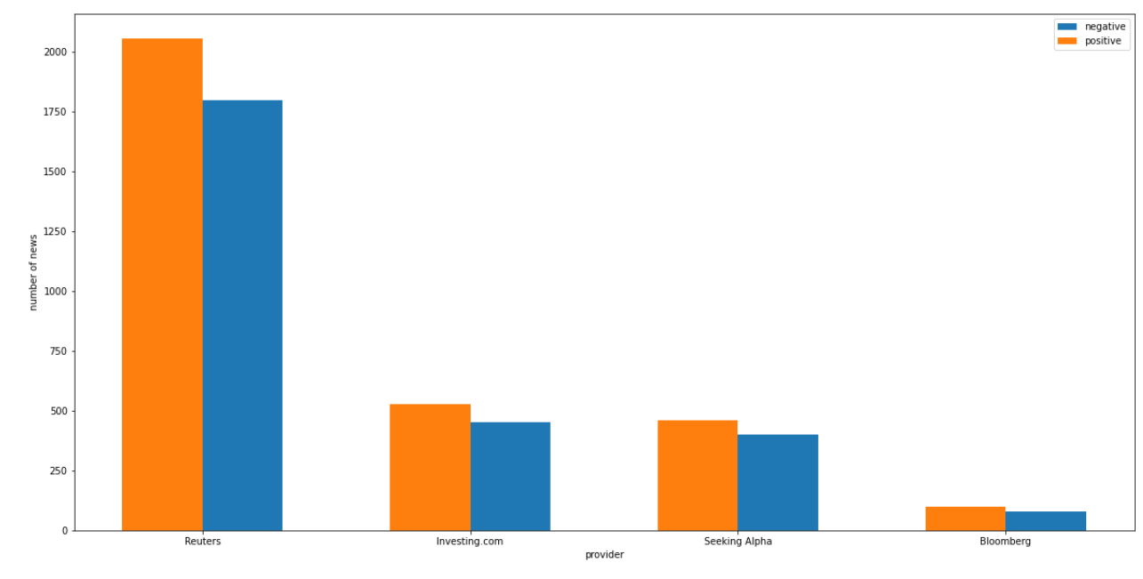
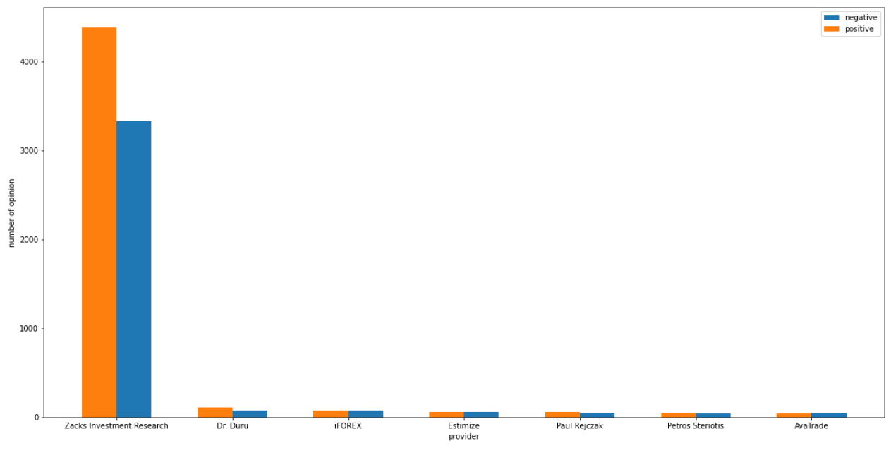
Yearly

Slide 41
Thank You
Fin – LAFIO Team

